Slide 1

Ericsson
- iPerf3
Mentors: Oskar Myrberg Anders Olsson
Team: Dominic Marks Qianwen Yan
Scott Weninger Weikang Yang

Slide 2
Outline
Introductions and Company Overview
The need for the app
What solutions the application offers
Schedule
Demo
Issues and Post Mortem Summary
What’s next?

Slide 3

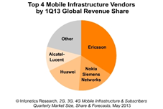
Ericsson
Founded in 1876 by Lars-Magnus Ericsson
Global headquarters: Stockholm, Sweden
Ericsson is one of the biggest providers of
wireless technologies.
Employs over 110,000 people worldwide

Slide 4
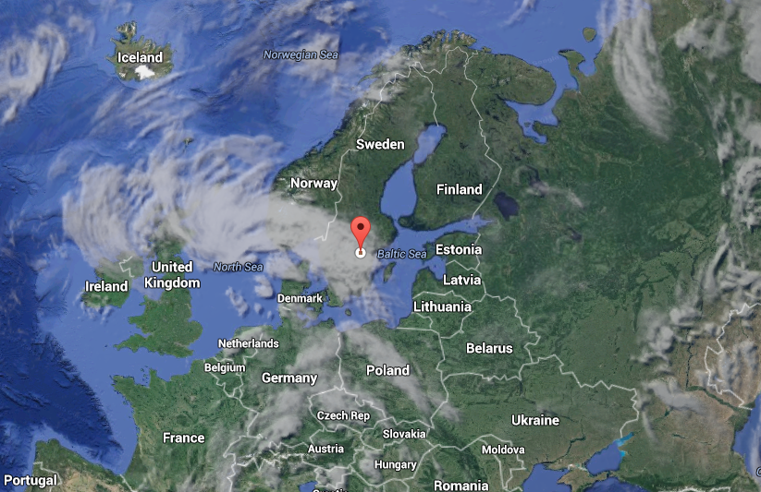
Our Mentors
Oskar Myrberg and Anders Olsson
Löcated in Linköping, Sweden
Löts of Vikings and Meatballs

Slide 5
The Issue to Tackle
IPerf3 is a network benchmarking application written in C
Android applications are written in Java and XML
To use IPerf3 on Android, the Android Native Development Kit (NDK) needs to be used for the C code

Slide 6
Goals of the Application
IPerf3 should provide basic networking information - speeds, device information, connection information, location information
Should be able to upload test results via e-mail and/or FTP to a central database
Should be able to run tests automatically at specified intervals (while driving around town, for example)

Slide 7
Schedule
Progress was slow at first when we were trying to get NDK to work.
Once that was working, progress went back to schedule
The last week was last minute panic

Slide 8
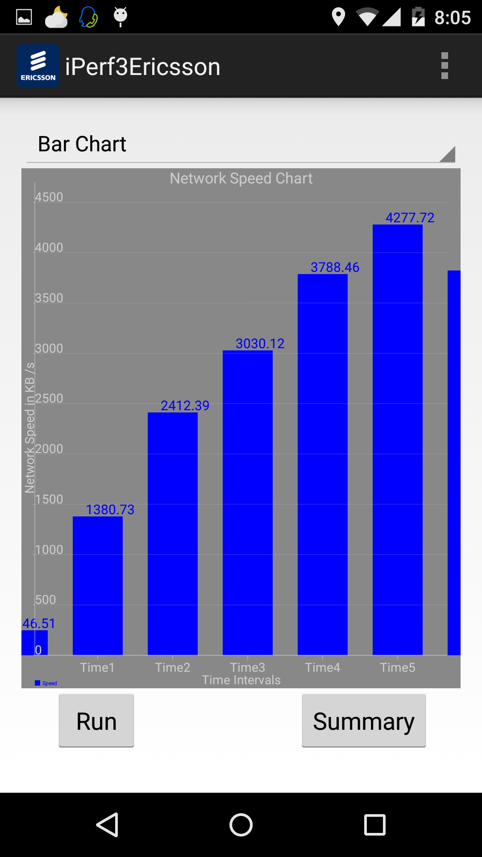
Screenshot

Slide 9
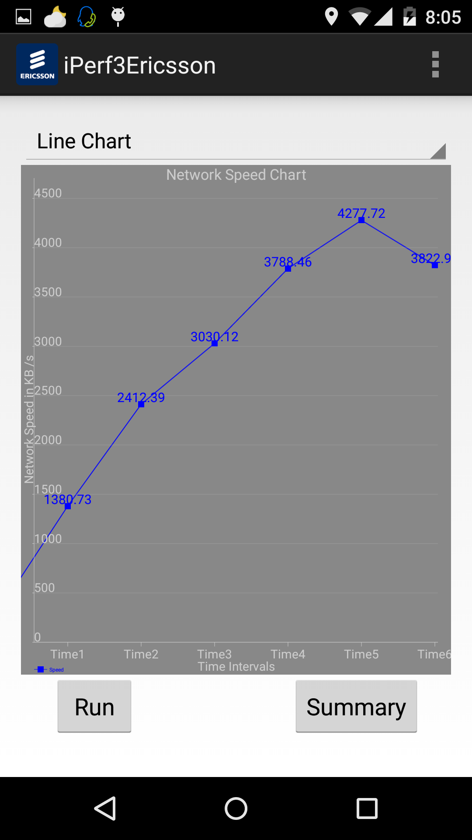
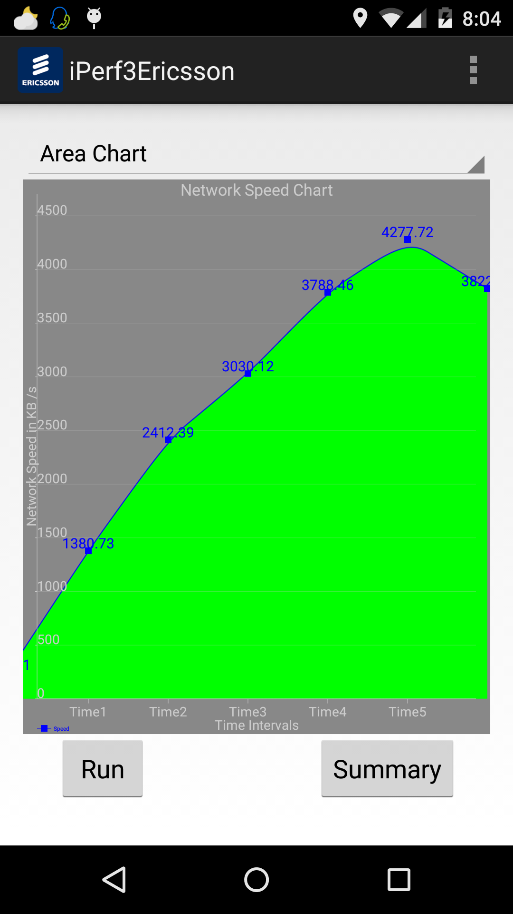

Slide 10
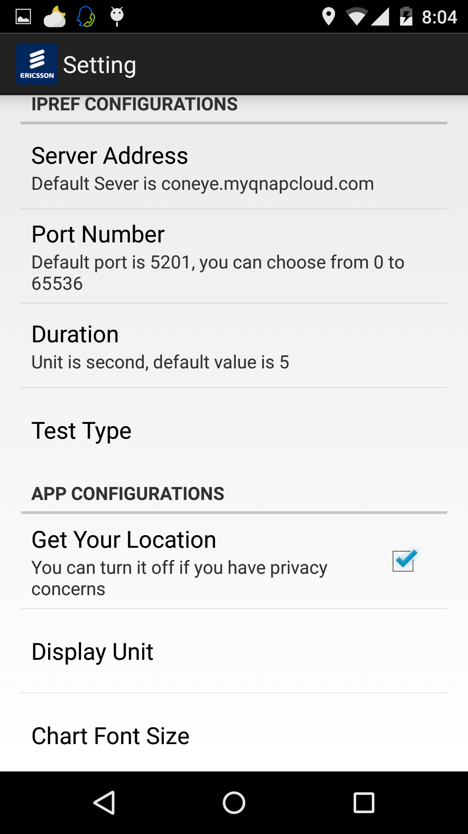
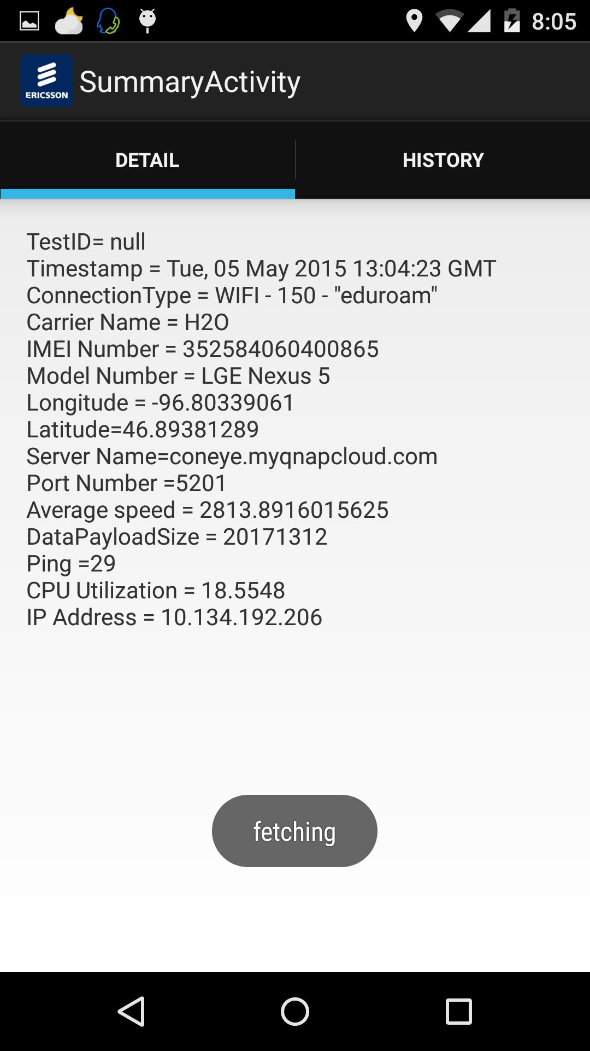

Slide 11
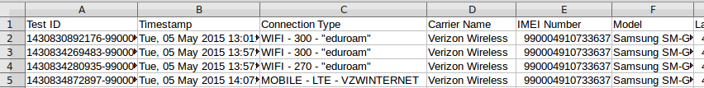
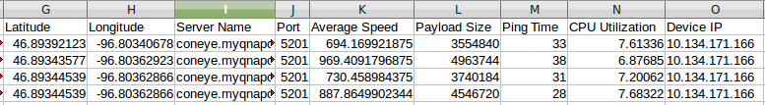
Database Output

Slide 12
Demo
Yay! The fun part!

Slide 13
Issues
Debugging NDK - limited tools and resources available for debugging, only basic support provided by Google
Various devices and manufacturers handle the NDK compiled code differently

Slide 14
Post-Mortem
One thing we would have done differently is start the project in Eclipse
One thing to remember is to stick to a long-term plan

Slide 15
What’s Next?
We will talk with Ericsson to identify any crashes or issues that happen - sometimes European networks can behave differently
Code handoff and presentation tomorrow

Slide 16
Any Questions?

